Slide 1
URBAN

Slide 2
What do these images have in common? As a group of photos how would you describe them?

Slide 3
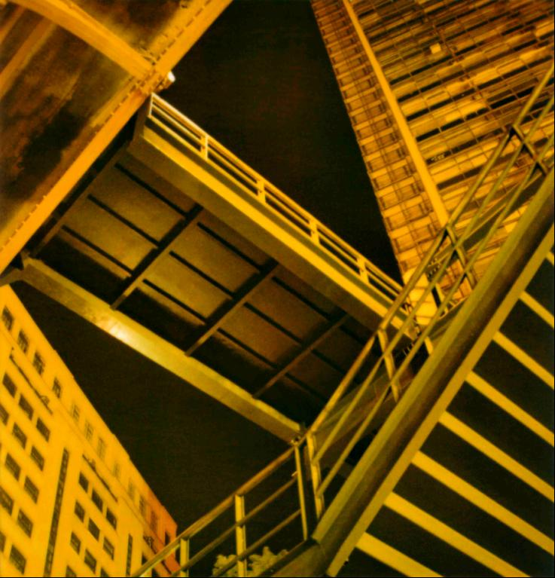
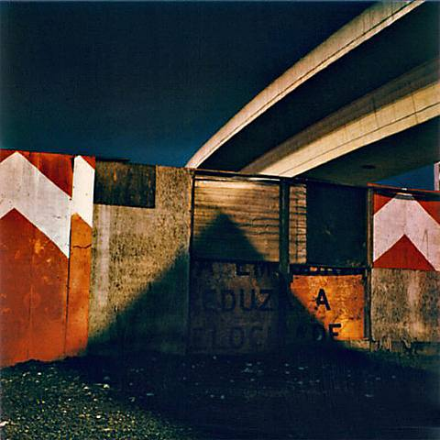
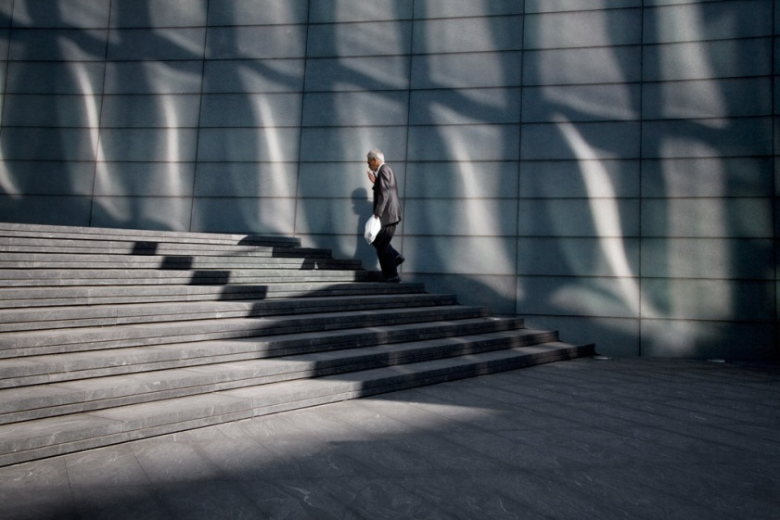
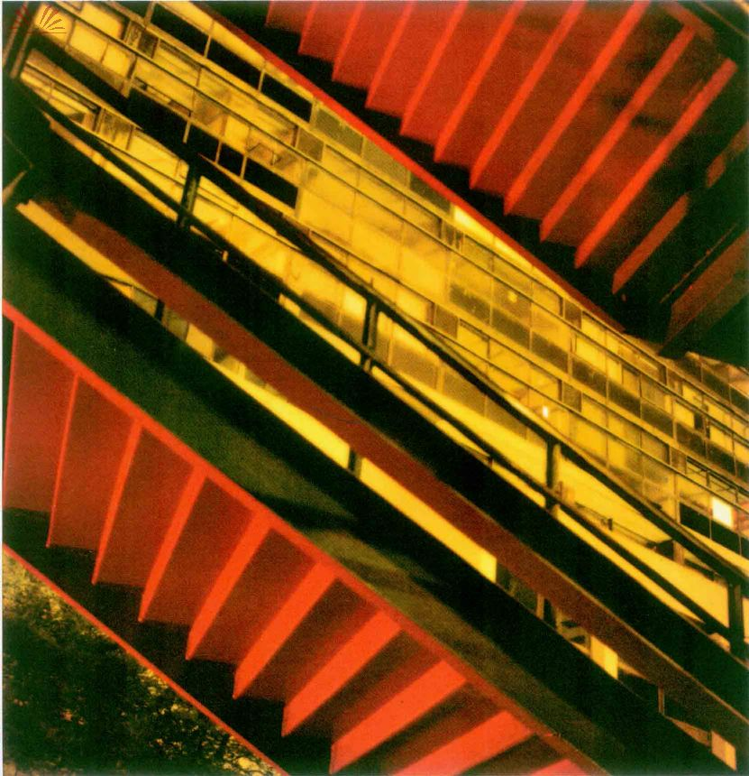
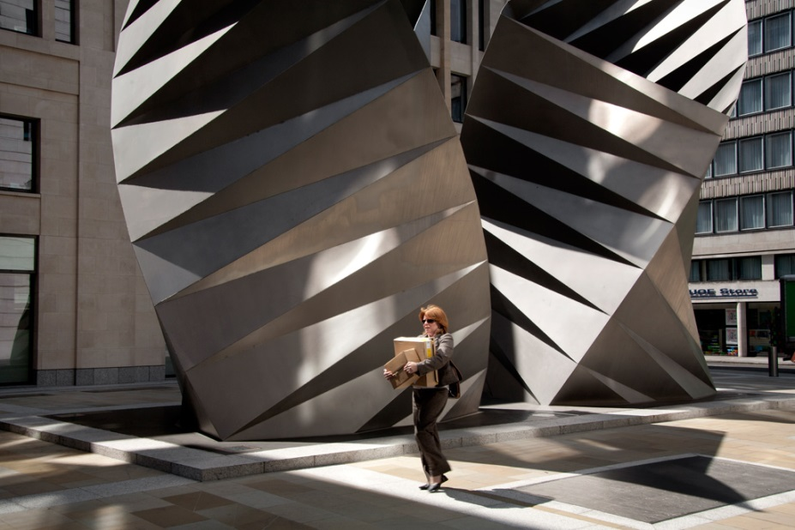
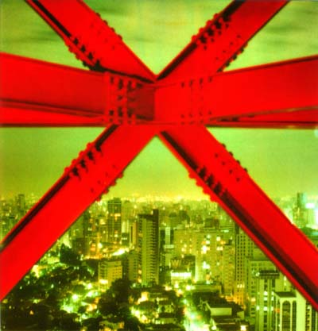
Cassio Vasconcellos
Polly Braden

Slide 4
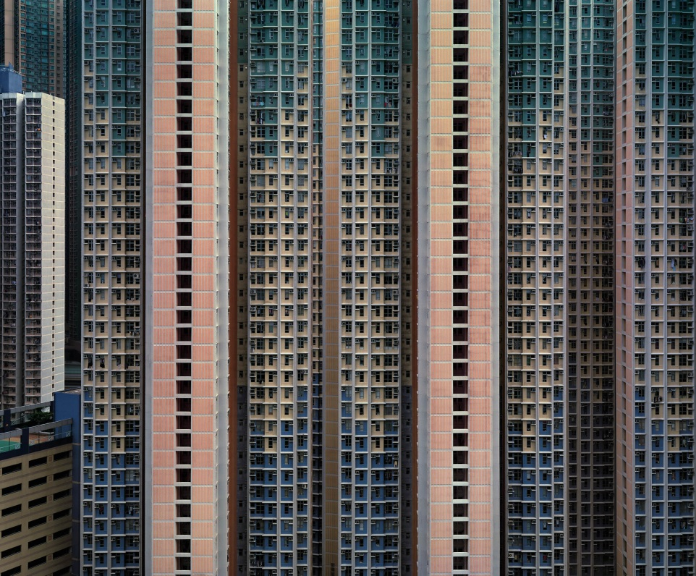
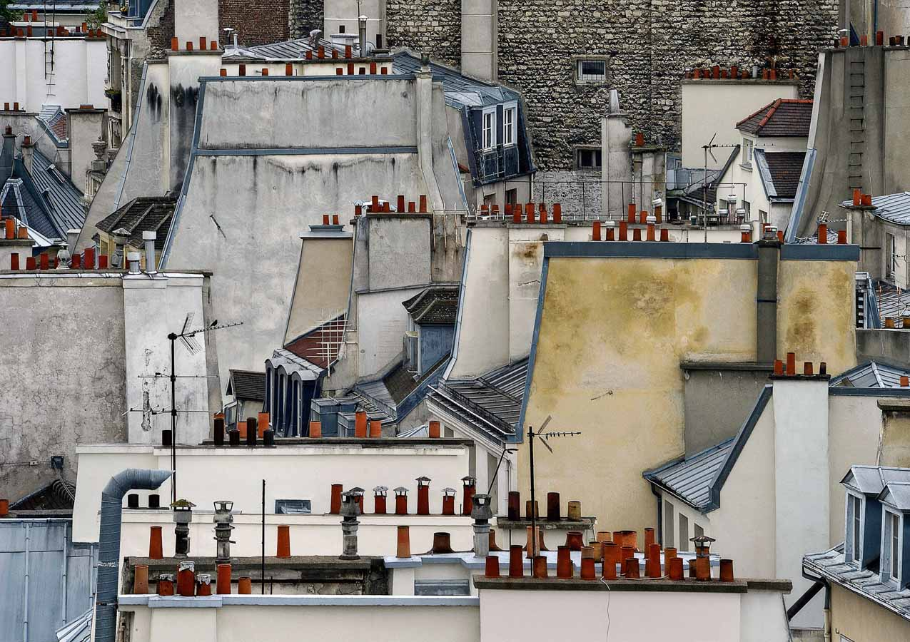
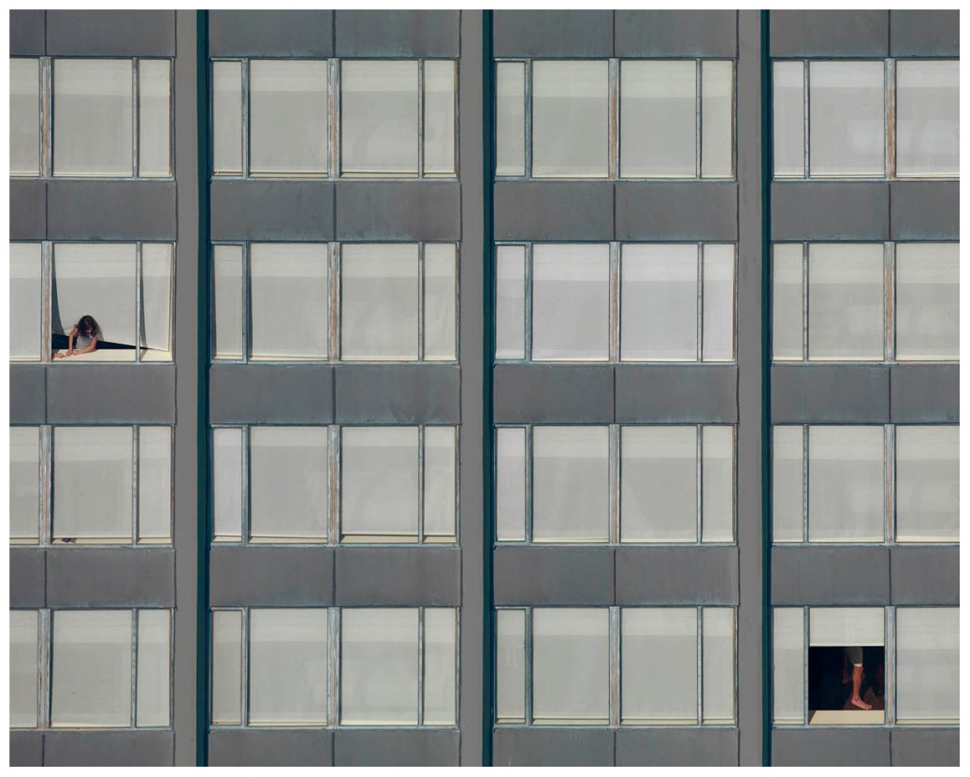
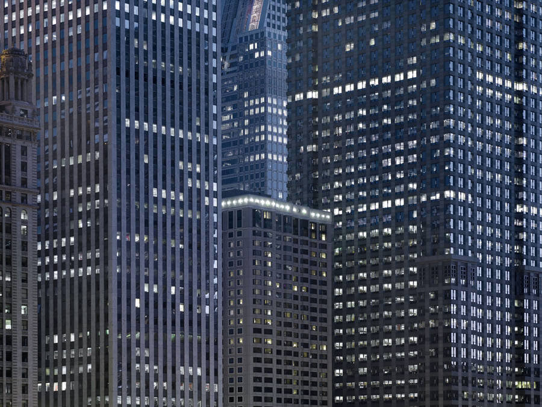
Michael Wolf

Slide 5
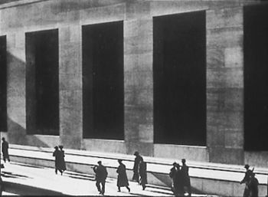
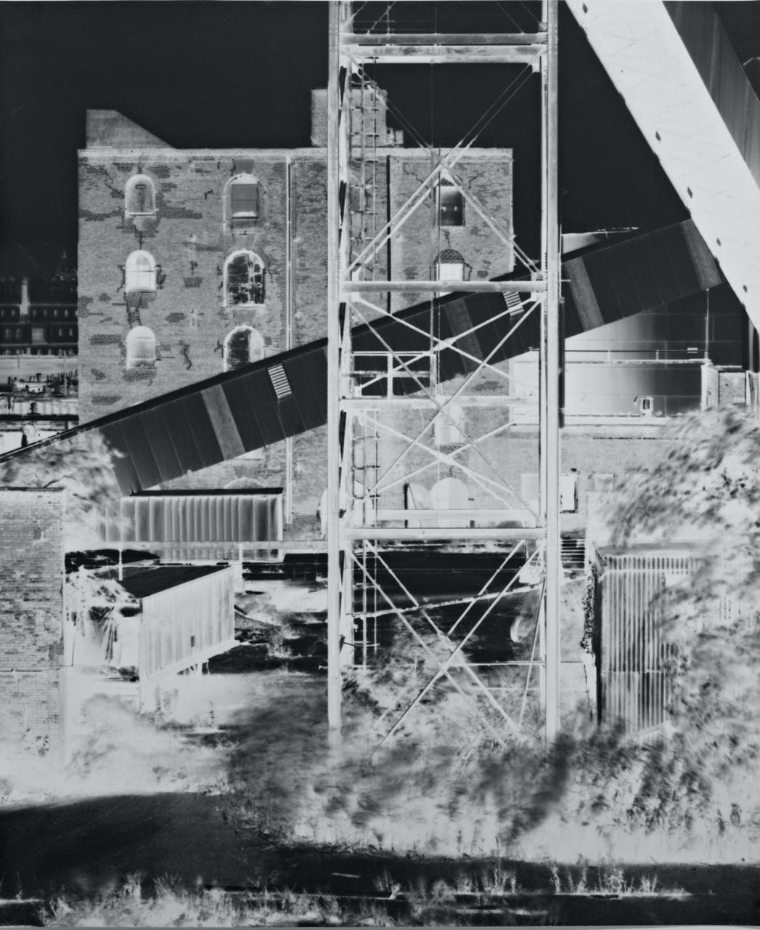
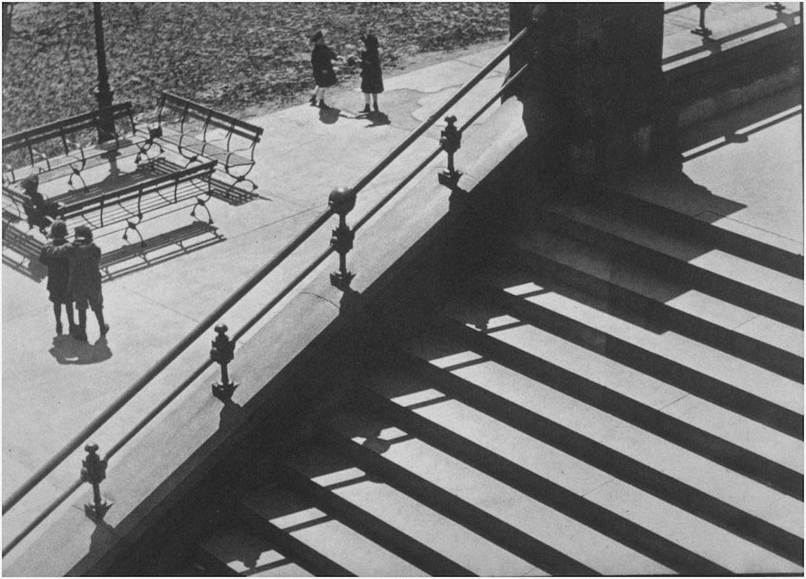
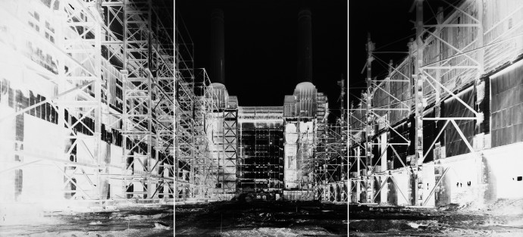
Vera Lutter
Paul Strand

Slide 6
What do these images have in common? As a group of photos how would you describe them?

Slide 7
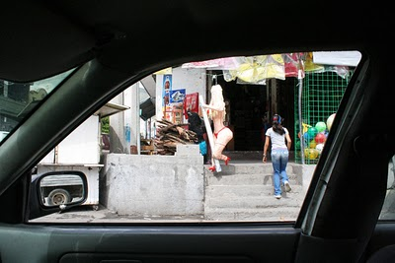
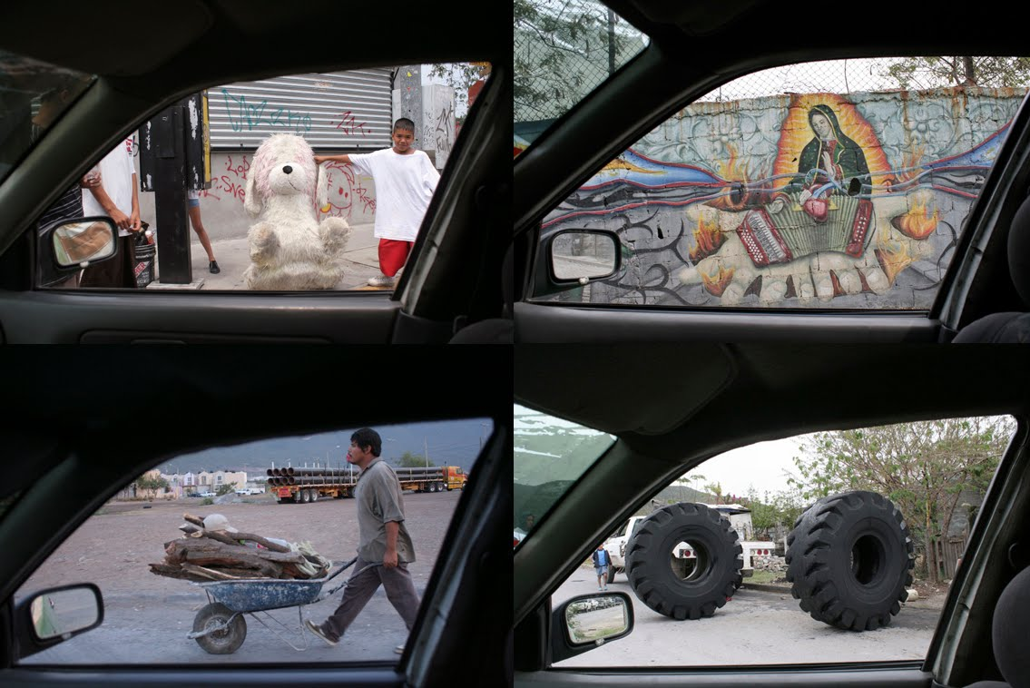
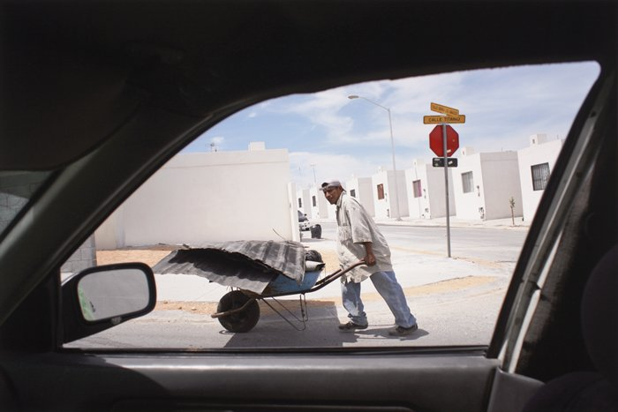
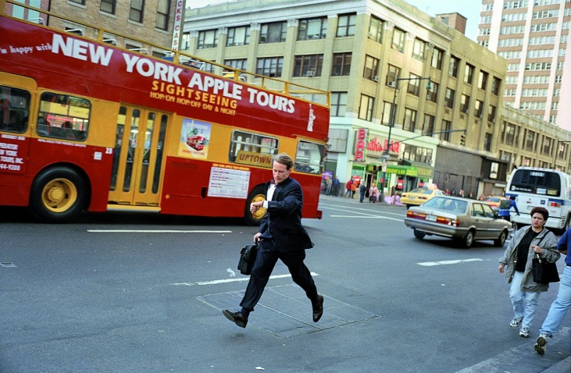
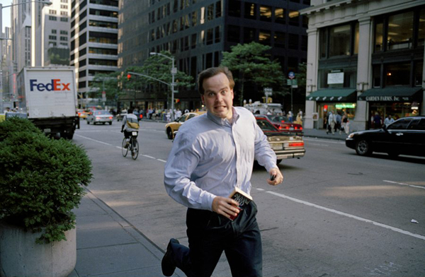
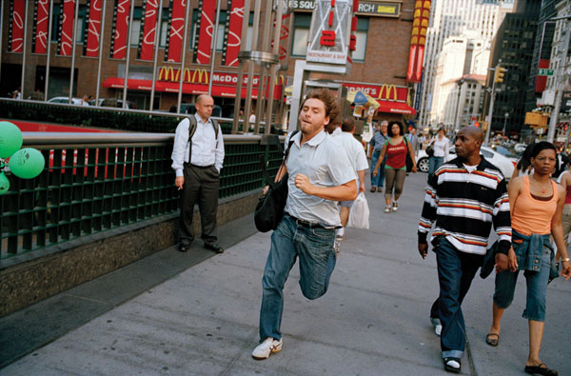
Oscar Fernando Gomez
Jeff Mermelstein

Slide 8
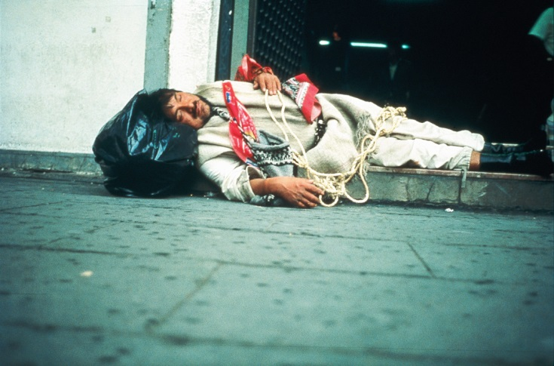
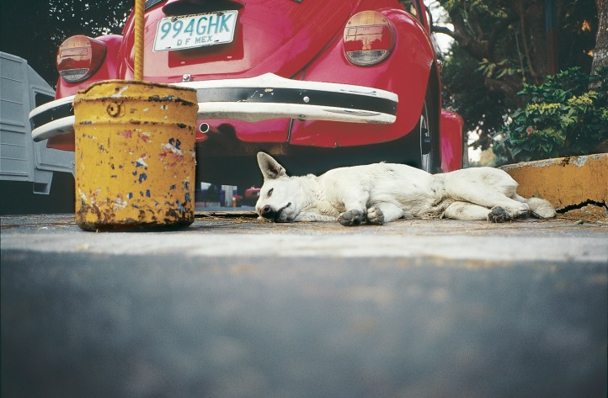
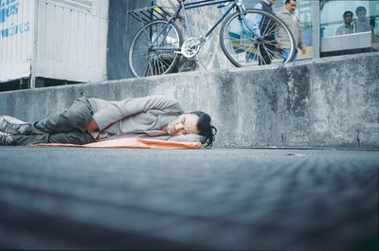
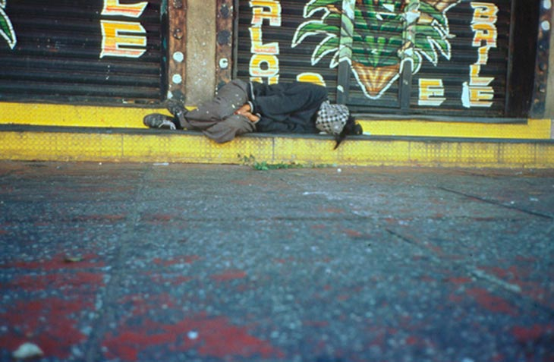
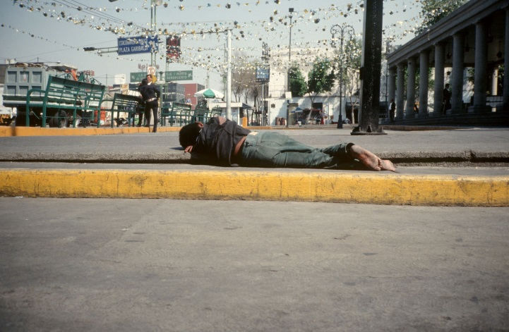
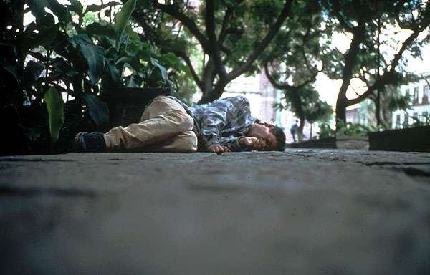
Francis Alys

Slide 9
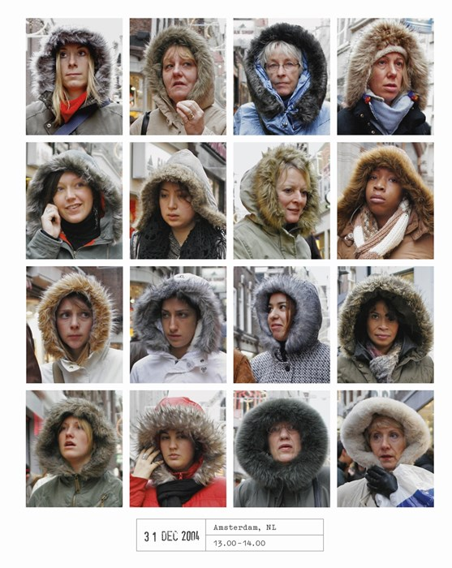
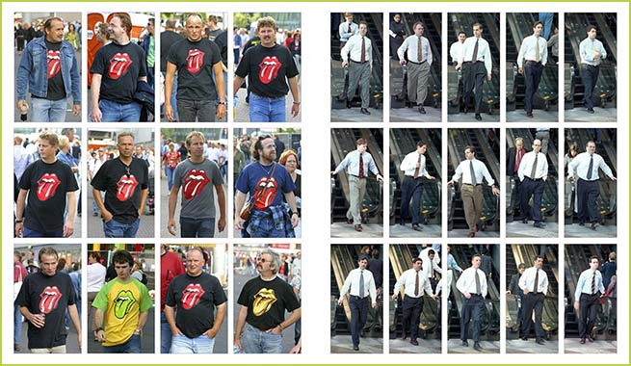
Hans Eilkelboom

Slide 10
What do these images have in common? As a group of photos how would you describe them?

Slide 11
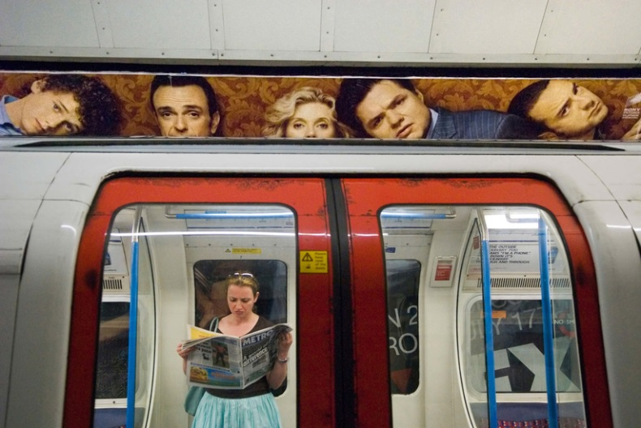
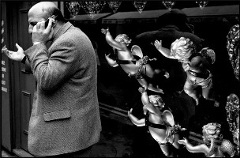
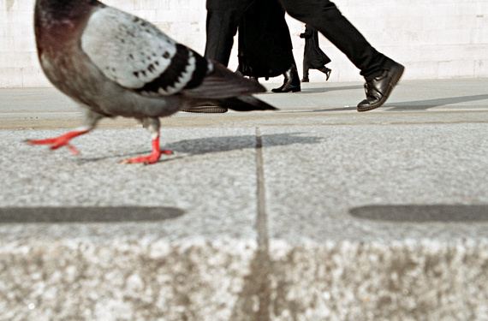
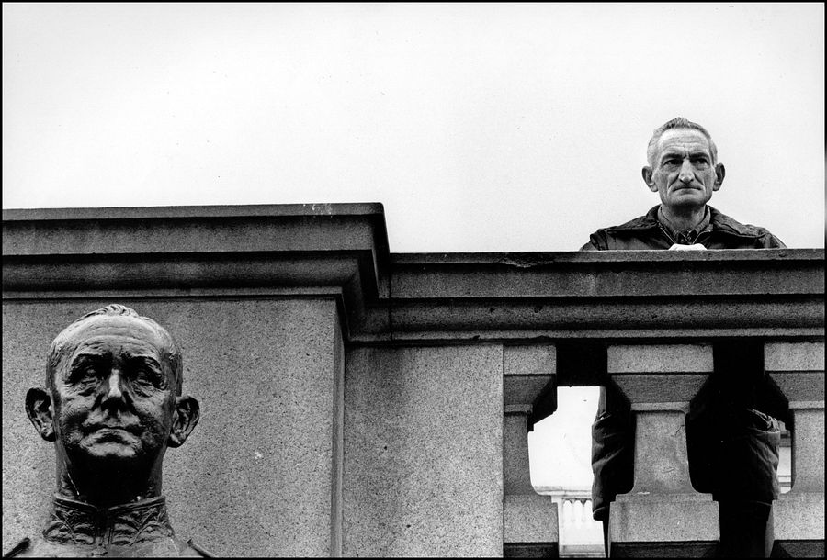
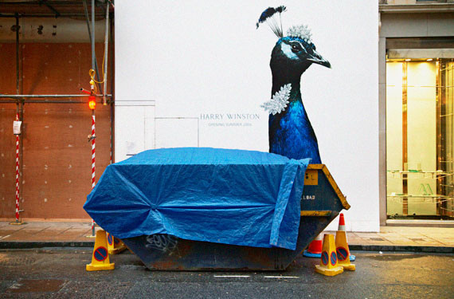
Matt Stuart
Nils Jorgensen

Slide 12
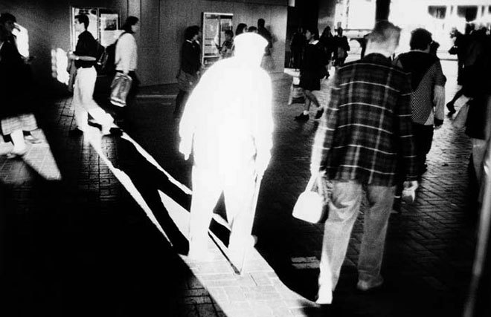
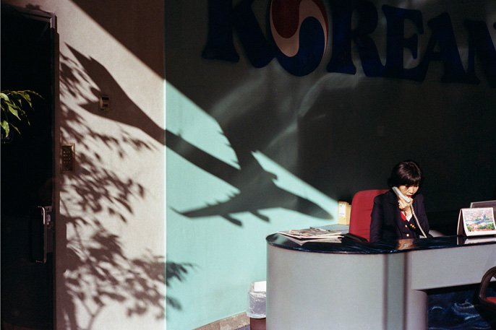
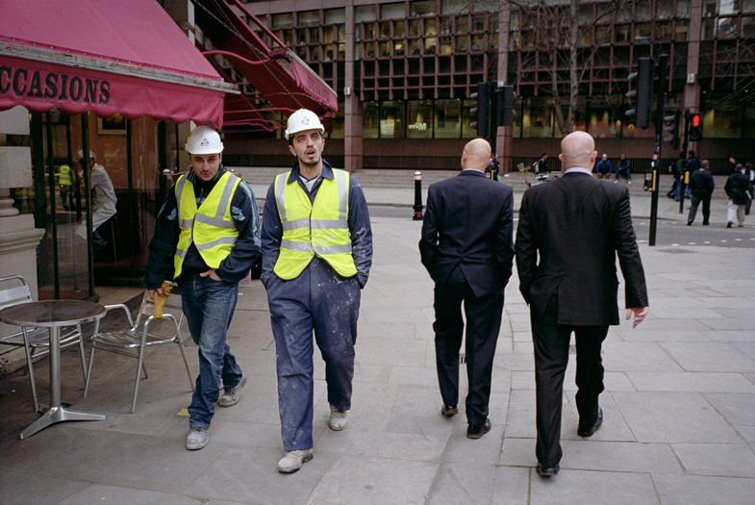
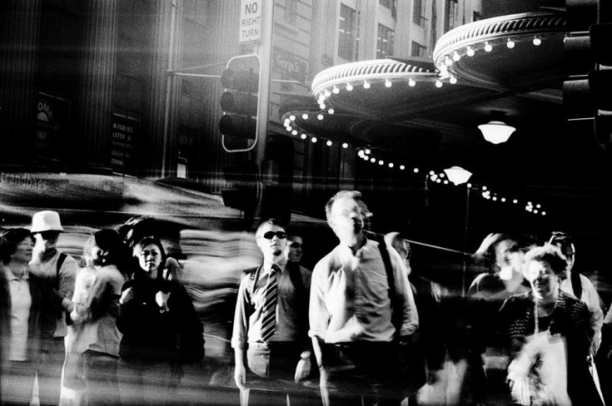
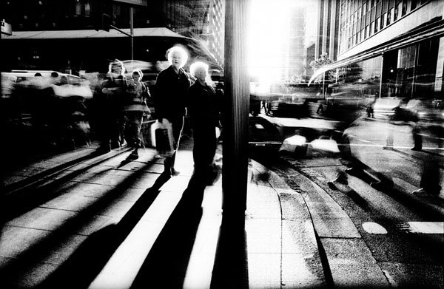
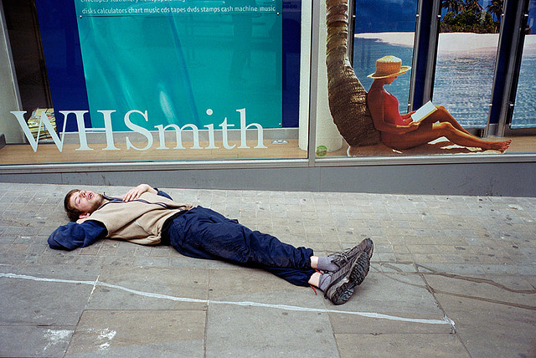
Nils Jorgensen
Nick Turpin

Slide 13
Create e new folder in your LMFS URBAN
Upload to your LMFS all your summer holiday work to 3 new folders – Abstract, repetition and capturing a moment.
Upload the photos you took on our trip last term to LMFS
Whilst that loads
Create a mind map power point slide using any of these different groups of URBAN photography:
Abstract - Cassio Vasconcellos, Polly Braden, Michael Wolf, Vera Lutter, Paul Strand. Moholy Nagy, Keld Helmer Peterson
Repetition - Oscar Fernando Gomez, Jeff Mermelstein, Francis Alys, Hans Eilkelboom
Capturing the moment - Matt Stuart, Nick Turpin, Nils Jorgenson,
Fill the slide with 8-19 photo examples and a title.
Save the slide as a picture and add to your website.
AO3

Slide 14
Photographer’s name
Photographer’s name
Photographer’s name
Urban
Photographer’s name
Photographer’s name
Photographer’s name
Photographer’s name
Photographer’s name

Slide 15
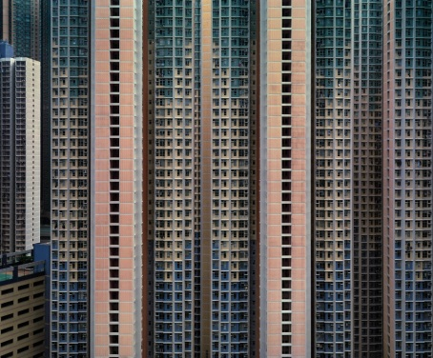
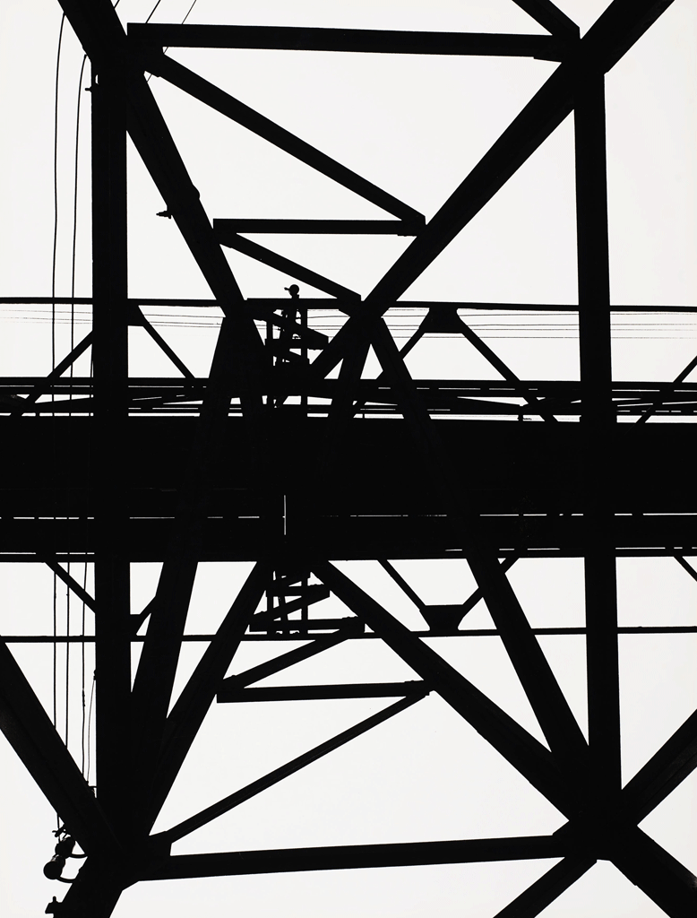
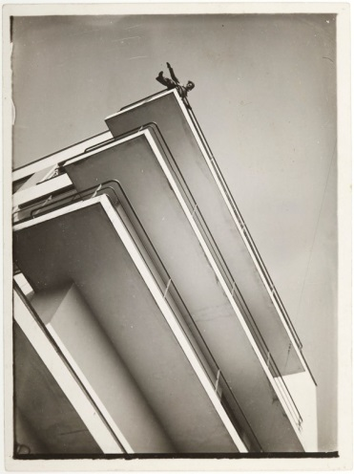
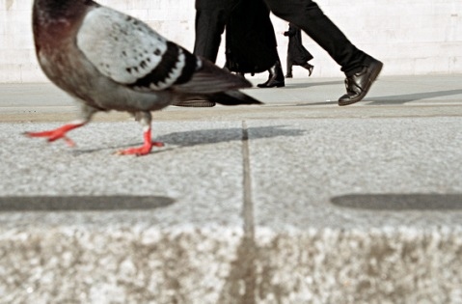
Michael Wolf
Paul Strand
Michael Wolf
Urban
Keld Helmer Peterson
Moholy Nagy
Nils Jorgensen
Nick Turpin
Matt Stuart
AO3

Slide 16
To explore new view points in order to develop the composition of your photographs
Homework 1 -View points
How can the camera see a street differently?
How can we look at a street in a different way?
How can we frame our pictures in a different way?
Look at these photographs, how has the photographer framed his pictures differently?
It is all about looking at things from a different point of view and noticing things that are hidden away.
Put yourself in a different position.
Due in Monday 14th Sept.
AO3

Slide 17
Homework 1 -View points
Explore new view points in order to develop the composition of your Urban photographs. Take at least 10 photographs. It is all about looking at things from a different point of view and noticing things that are hidden away.
Upload your images onto your website
Due in Monday 14th Sept.
Homework 1 -View points
Explore new view points in order to develop the composition of your Urban photographs. Take at least 10 photographs. It is all about looking at things from a different point of view and noticing things that are hidden away.
Upload your images onto your website
Due in Monday 14th Sept.
Homework 1 -View points
Explore new view points in order to develop the composition of your Urban photographs. Take at least 10 photographs. It is all about looking at things from a different point of view and noticing things that are hidden away.
Upload your images onto your website.
Due in Monday 14th Sept.
Homework 1 -View points
Explore new view points in order to develop the composition of your Urban photographs. Take at least 10 photographs. It is all about looking at things from a different point of view and noticing things that are hidden away.
Upload your images onto your website
Due in Monday 14th Sept.

Slide 18
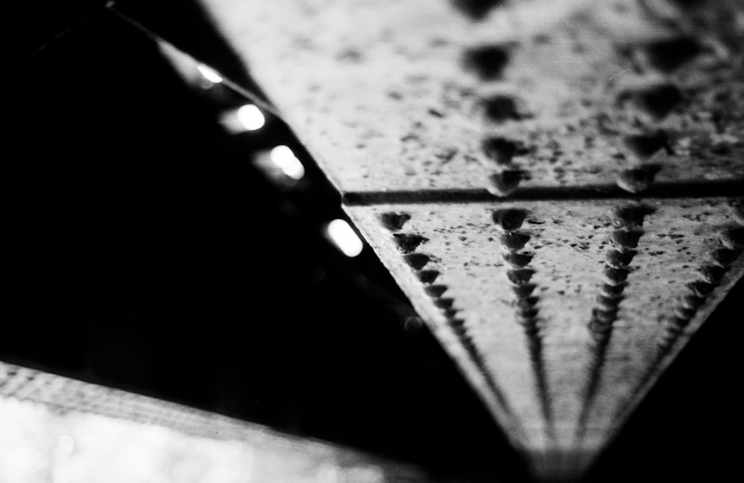
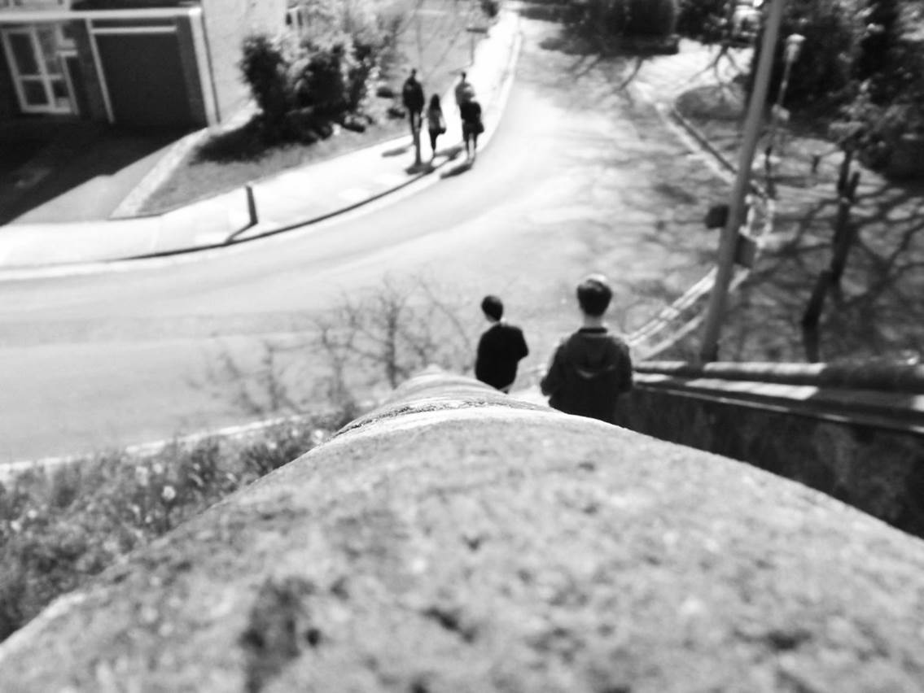
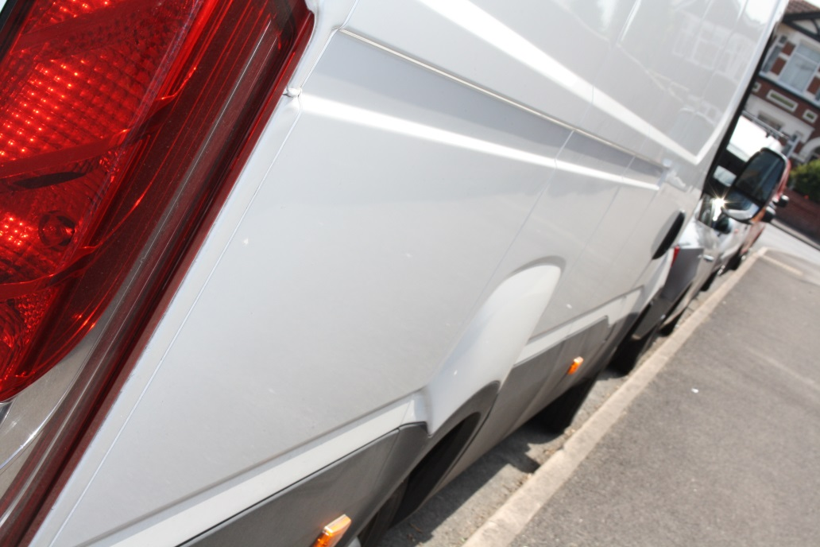
Changing the viewpoint

Slide 19
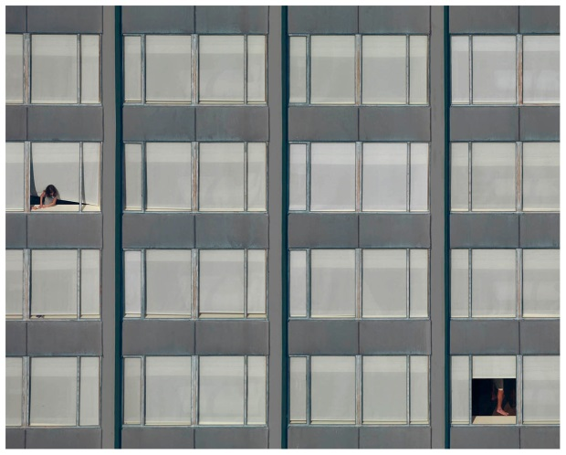
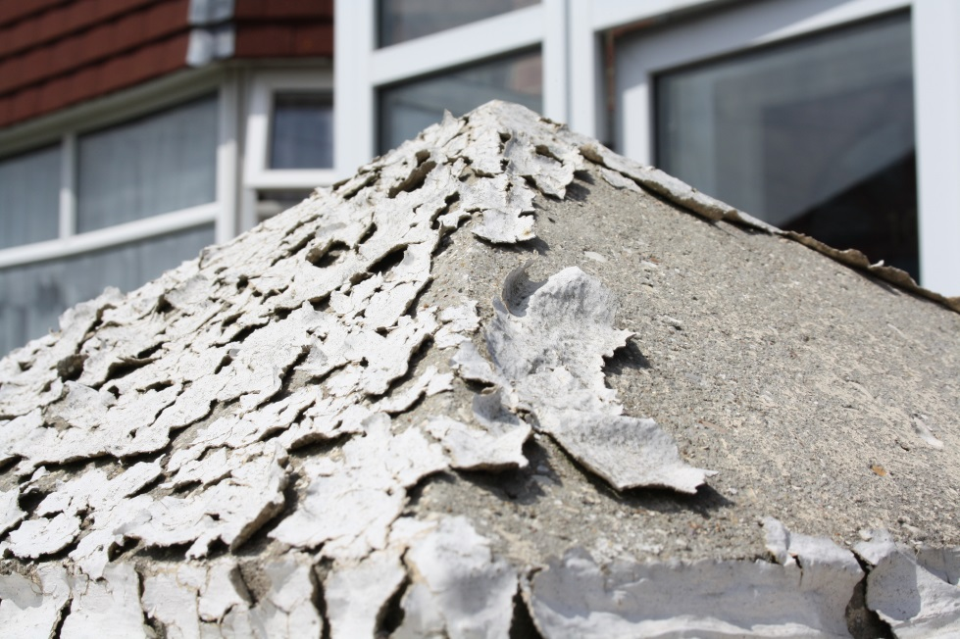
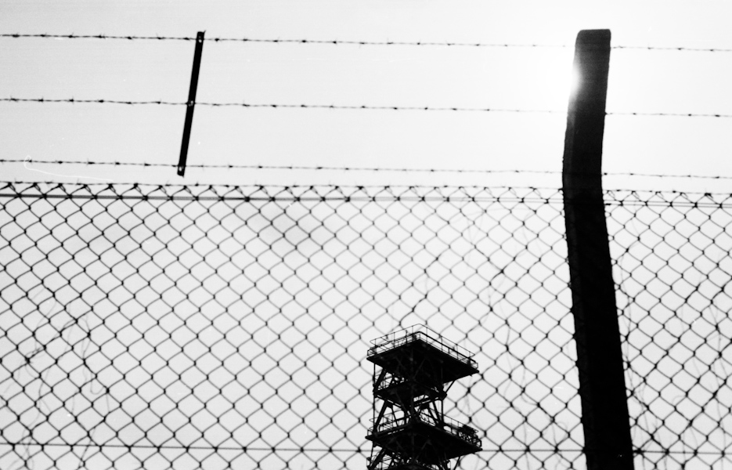
Cropping to show pattern

Slide 20
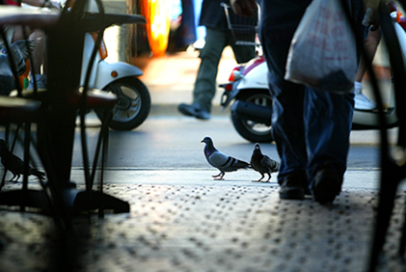
Framing your shot

Slide 21
It is all about looking at things from a different point of view and noticing things that are hidden away.
Put yourself in a different position.

Slide 22
Summer Homework - Abstract
Task 1 –
Abstract
Take 10+ photos of the urban landscape with shapes and patterns as the theme.
Create a title Abstract , insert a gallery and upload your homework photos to your website
AO3
AO1

Slide 23
Summer Homework - Repetition
Task 2-
Take 10+ photos of the urban landscape with a repeated viewpoint or subject
Create a title Repetition , insert a gallery and upload your homework photos to your website
AO3

Slide 24
Summer Homework – Capturing the moment
Task 3-
Take 10+ photos that captures a moment in the urban landscape.
Create a title Capturing a moment , insert a gallery and upload your homework photos to your website
AO3

Slide 25
Lesson Objective :To be able to collate my research ideas and photographs
Create a new title – Abstract city centre.
You will upload the photos you took last term. Make sections to show similarities
For example:
Looking up
Looking down
Finding colour
Add text to describe each theme –
For example
Looking up – I took this sequence of photos looking up at different styles of architecture. I like the way the shapes are repeated against the cloudy sky.
Upload the best of these photos to your website – look at the example in the Urban section-
Edit a series of these photos and write about why you choose these and how you edited them.
AO3

Slide 26
Preparation for photoshoot 2-Viewpoints
You will take at least 8 photos for each of the following
Looking up
Looking down
Unusual viewpoint
Cropping to show or create pattern
Using shadows
PLUS any other themes you notice
Remember the theme is URBAN
AO3

Slide 27
LOOKING UP
LOOKING DOWN

Slide 28
UNUSUAL VIEWPOINT
CROPPING TO SHOW PATTERN

Slide 29
SHADOWS

Slide 30
You will take at least 8 photos for each of the following
Looking up
Looking down
Unusual viewpoint
Cropping to show or create pattern
Using shadows
PLUS any other themes you notice
You will take at least 8 photos for each of the following
Looking up
Looking down
Unusual viewpoint
Cropping to show or create pattern
Using shadows
PLUS any other themes you notice

Slide 31
Lesson Objective: To be able to collate and refine your photoshoot images
Within the URBAN folder create – photoshoot 1 – save the photos you took last week and your homework into that folder.
Create a title– VIEWPOINTS
Add a text box - In these photographs I looked at a suburban street from different viewpoints. I concentrated on changing the viewpoint cropping to show pattern framing the image
Upload the best of those images into a gallery. Edit 2 or 3 images using colour/B&W/levels/filters in photoshop
AO3

Slide 32
Homework: Find 6 photos by Michael Wolf of cities
Write about Michael Wolf –
What are his themes?
Where does he take photos?
What techniques does he use?

Slide 33
AO1- Understanding, using and developing the work of photographers and artists
Michael Wolf
Create a title on your website Michael Wolf. Upload your 6 images of his urban photography and upload to a gallery

Slide 34
Photography analysis word bank
Lesson 2
Visual language – the top 10 things to talk about
Technique | Colour | Composition | Shape | Subject
Light | Media | Mood | Style | Story
Word Bank
Colour | Composition | Mood | Style | Light | Technique | Media
Bright Clashing Cold Contrast Deep Dull Glowing Harmonious Hue Intense Luminous Monochrome Opaque Pale Pure Saturation Transparent Vibrant Warm | Angle Background Blurred Balance Complex Distance Eye line Framing Focus Foreground Form Line Middle ground Movement Near Perspective Scale Space Shape Symmetry Torn Tryptic Thumbnail | Alive Atmospheric Calm Delicate Depressing Dignified Disturbing Fresh Exciting Flamboyant Expressive Humorous Imposing Nostalgic Sad Sentimental Setting Tranquil | Abstract Content Derivative Documentary Distorted Emotional Exaggerated Fake Fantasy Figurative Landscape Religious Repetition Representational Still life Surreal Symbolic Intention Theme | Aperture Aperture priority Artificial Contrast Chroma Dark Develop Exposure Focus Filter Evening Fierce Gentle Harsh Hazy ISO Intense Lens Natural Shady Shadowy Warm | Texture Calibration Digital F-Stop Layered Panorama Pixelization Resolution Solarized Shutter priority Shutter speed Depth of field | Collage Digital Paint Print Photograph Mixed media Photoshop Pixel Noise Film photography Cyanotype Pin hole
You have 3 minutes…….
Underline all the words that relate to Victor Schrager’a photograph

Slide 35
AO1
What common features can you see?
Write as many as you can in your journal.
Michael Wolf

Slide 36
Analyse this photograph using the formal elements. A blank template is in Pool for you.
Light-
Composition-
You can choose which photo you would like to analyse
Repetition-
Focus-
Shape-
Mood-
I find this photograph interesting because
I will use the techniques that Schrager has shown by
AO1- Understanding, using and developing the work of photographers and artists

Slide 37
AO1- Understanding, using and developing the work of photographers and artists
Keld Helmer Peterson
Photoshoot in Southampton city centre
Michael Wolf
Moholy-Nagy

Slide 38
Use these photographers as your inspiration today. Look for: patterns, silhouettes, abstract shapes. Look up, zoom in, crop.
Use these photographers as your inspiration today. Look for: patterns, silhouettes, abstract shapes. Look up, zoom in, crop.
Keld Helmer Peterson
Keld Helmer Peterson
Michael Wolf
Michael Wolf
Moholy-Nagy
Moholy-Nagy

Slide 39
AO1
Photoshoot :
MY RESPONSE TO MICHAEL WOLF. Take at least 15 photographs using Schrager’s style and techniques.
Michael Wolf
Create a title on your website Michael Wolf. Find 6 images of his urban photography and upload to a gallery

Slide 40
Learning Objective: To be able to response to the techniques of Michael Wolf
Present all your Michael Wolf photos in a gallery, entitled My response to Michael Wolf
Select the best 4 photos. How can they be improved?
Use some of these editing tools to improve:
Cropping
Increasing contrast – Image-adjustments-brightness/contrast
Changing the colour hue– image-adjustments-levels or image-adjustments-hue/saturation-saturation
Upload showing the original next to the edited version. Refining my response to Wolf
Teacher example
AO2- Understanding, using and developing the work of photographers and artists

Slide 41
Lesson Objective: To be able to edit and refine my photos to show a theme
Lesson Objective: To be able to edit and refine my photos to show a theme
Find 4 photos by Moholy-Nagy and add them to weebly in a slide show.
Describe his “looking up” technique in your own words
Find 4 photos by Moholy-Nagy and add them to weebly in a slide show.
Describe his “looking up” technique in your own words
Moholy-Nagy
Moholy-Nagy
Moholy-Nagy liked photographing buildings close-up from the ground. He chose modern buildings with sharp, clearly defined edges and simple shapes. Sometimes he included a figure to give a sense of scale. When you stand close to a tall structure and look up the perspective is exaggerated. The resulting images can be quite abstract
Moholy-Nagy liked photographing buildings close-up from the ground. He chose modern buildings with sharp, clearly defined edges and simple shapes. Sometimes he included a figure to give a sense of scale. When you stand close to a tall structure and look up the perspective is exaggerated. The resulting images can be quite abstract

Slide 42
Lesson Objective: To be able to edit and refine my photos to show a theme
Moholy-Nagy liked photographing buildings close-up from the ground. He chose modern buildings with sharp, clearly defined edges and simple shapes. Sometimes he included a figure to give a sense of scale. When you stand close to a tall structure and look up the perspective is exaggerated. The resulting images can be quite abstract
Find 4 photos by Moholy-Nagy and add them to your website in a gallery.
Describe his “looking up” technique in your own words
Moholy-Nagy
AO1- Understanding, using and developing the work of photographers and artists

Slide 43
Lesson Objective: To be able to edit and refine my photos to show a theme
Inspired by Moholy-Nagy's pictures of buildings I took these images of the different styles of buildings, standing close to the building and looking straight up. I tried to make the composition the same in each one, placing the apex of the triangle in the centre of the image.
Choose an image with clear edges and use this process to develop an abstract pattern

Slide 44
Lesson Objective: To be able to describe the work of a photographer using the formal elements
Keld Helmer Peterson
The silhouettes that are created by these highly contrasted photographs show the stark industrial nature of the urban environment. Peterson focused on the composition with lines and shapes overlapping to make the bold photographs. I am inspired by this approach and will use the elements of line and contrast to investigate my urban environment.
Create a title on your website Keld Helm Peterson.Upload your 6 images of his urban photography and upload to a gallery
Use the photos by Keld Helmer Peterson in POOL and add them to your website in a slide show.
Describe his technique in your own words

Slide 45
Lesson Objective: To be able to edit and refine my photos using Peterson’s style
Keld Helmer Peterson

Slide 46
Lesson Objective: To be able to refine your photoshoot images effectively
Examples of writing…
I cropped this photograph to make the pattern the dominant feature. I was influenced by Michael Wolf and his photographs of urban skyscrapers
I made the photograph black and white and then increased the contrast. This emphasises the strong vertical lines and draws the viewer into the photograph.
I have changed the colour by altering the hue. This makes the colours appear to be pastel . I was influenced by the photographs of skyscrapers by Michael Wolf.
I have made this photograph black and white only with no grey tones. This makes a strong silhouette . I was influenced by Keld Helmer Peterson and his bold abstract photos of urban industry.
I am looking for:
A clear link to one of the photographers
A documented approach – you must show every stage of editing and write what you did and why you did it.

Slide 47
Lesson Objective: To be able to develop a personal theme
Choose a theme to base the rest of your project on.
Abstract - Micheal Wolf, Keld Helm Peterson, Lazlo Maholy-Nagy
Capturing the moment – Nick Tirpin, Matt Stuart
Repetition – Michael Wolf, Lazlo Maholy Nagy
Viewpoints – Francis Alys, Paul Strand
Obscured architecture– Gerhard Ritcher , David Hepher, Alexey Titaremko

Slide 48
Abstract
Keld Helmer Peterson
Michael Wolf
Moholy-Nagy

Slide 49
Capturing a momentt
Nick Turpin
Matt Stuart

Slide 50
Repetition
Lazlo Maholy Nagy
Michael Wolf

Slide 51
Francis Alys
Viewpoints
Paul Strand

Slide 52
Obscured architecture
David Hepher
Gerhard Richter

Slide 53
Alexey Titarenko

Slide 54
Learning objective: To be able to refine your ideas to make a final piece
Change and experiment with COMPOSITION I have shown my inspiration I have tried out my ideas I have annotated my ideas | Change and experiment with LIGHTING I have shown my inspiration I have tried out my ideas I have annotated my ideas | Change and experiment with MEDIA - digital/non-digital I have shown my inspiration I have tried out my ideas I have annotated my ideas
Change and experiment with CROPPING/LAYERING/ COLLAGE I have shown my inspiration I have tried out my ideas I have annotated my ideas | I have shown all the elements of my final piece. I have evaluated my final idea I am confident this is the best version of my idea. | Change and experiment with IMAGE I have shown my inspiration I have tried out my ideas I have annotated my ideas
Change and experiment with PHOTOGRAPHER/ ARTIST INFLUENCE I have shown my inspiration I have tried out my ideas I have annotated my ideas | Change and experiment with FINAL PRESENTATION I have shown my inspiration I have tried out my ideas I have annotated my ideas | Change and experiment with COLOUR I have shown my inspiration I have tried out my ideas I have annotated my ideas
Cross off each development
C grade = 3 squares
B grade = 6 squares
A/A*= 9 squares

Slide 55
Choosing your focused theme for the Urban project
Now that your are starting to develop your project into a final outcome you need to decide on a focused theme. Choose one of the following areas below.
Choose a theme to base the rest of your project on.
Abstract - Micheal Wolf, Keld Helm Peterson, Lazlo Maholy-Nagy
Capturing the moment – Nick Turpin, Matt Stuart
Repetition – Michael Wolf, Lazlo Maholy Nagy
Viewpoints – Francis Alys, Paul Strand
Obscured architecture– Gerhard Ritcher , David Hepher, Alexey Titaremko
The theme I will choose is:
The photographer I now need to research is:
Over half term research your theme by taking 20+ photographs inspired by the photographer or photographers .
Research the new photographer or photographers , collect images and analyse their work.
Half Term Photography Workshop
Improve your GCSE Coursework
Monday 24th October 9am – 2pm Room 9
Please enter Room 9 from the playground side
as the corridor carpet is being changed.

